Slide 1

Master’s Degree Course in Electronic Engineering for Industry Industrial Automation Speech Recognition System to control a Robotic Arm
Written by:
Alessandro Ficarra Roberto Cardillo Gabriele Ielo Gabriele Ruggeri
Professor: Prof. L. Patanè
Academic year 2022-2023

Slide 2
Hardware Components
Siemens SIMATIC S7-1200 1215C AC/DC/RLY PLC
The PLC SIMATIC S7-1200 with CPU 1215C AC/DC/RLY is a PLC produced by Siemens. It is used in the project to realize the sequence control of the robotic arm.
It is characterized by:
• 14 24V digital inputs;
• 10 relay outputs;
• 2 analog inputs and 2 analog outputs.

Slide 3
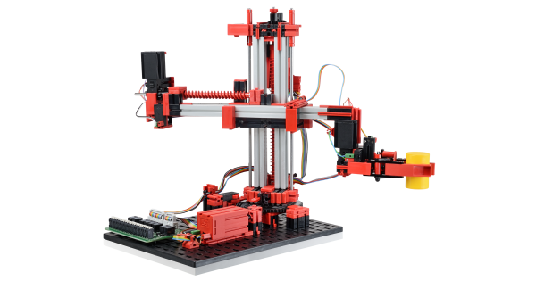
Fischertechnik 3D-Robot 24V
The 3D-Robot 24V is a robotic arm produced by Fischertechnik. It is a 3-DOF (3 degrees of freedom) robot and it is composed by:
• 1 revolute joint;
• 2 prismatic joints (up/down and forward/backward);
• 1 gripper as end-effector

Slide 4
End of Run switches
The robotic arm as four mini switches that are pressed respectively in four different conditions:
• the gripper is fully open;
• the end-effector is completely brought back;
• the horizontal arm is completely brought up;
• the robot is completely rotated clockwise.

Slide 5
Pulse counters and Motor encoders
The robot has two pulse counters, that can be used to understand respectively:
• how much the gripper is open;
• how much the horizontal arm is moved frontward.
In fact, the pulse counters are switches that are automatically pressed each time a gear
involved in the corresponding movement rotate of a certain angle, producing a certain
quantity of movement.
The robot has two motor encoders with a maximum frequency of 1 KHz, that can be used to understand respectively:
• how much the horizontal arm is moved down;
• how much the robot is rotated.
The direction of the movement/rotation can be understood by the time order of the two
signals generated by the encoder.

Slide 6
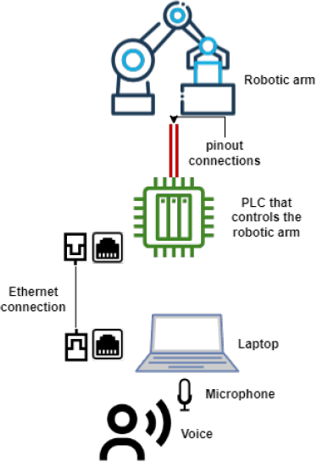
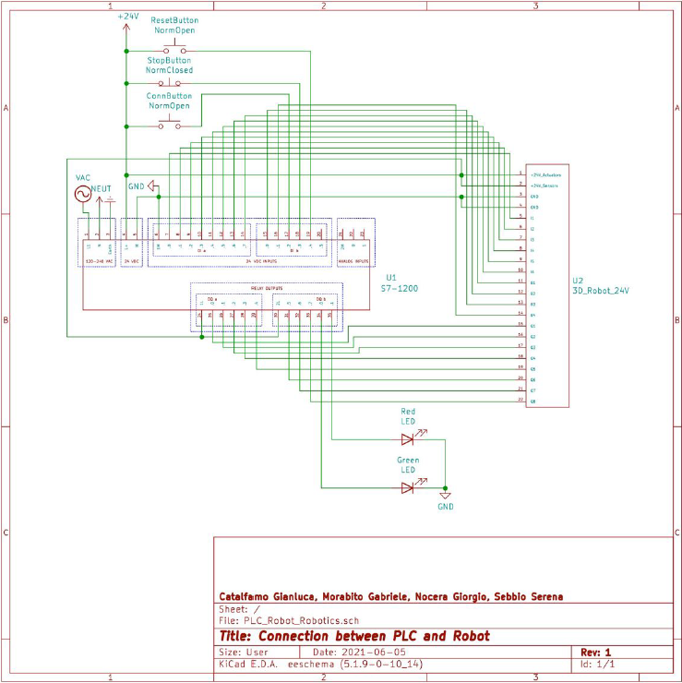
Connection with the robotic arm
In this section it is presented the part related to the connection between the user computer and the PLC that controls the robotic arm.
Here’s a graphical scheme of how the connection is set up (on the right) and its KiCad schematic (below):

Slide 7
TIA Portal

Slide 8
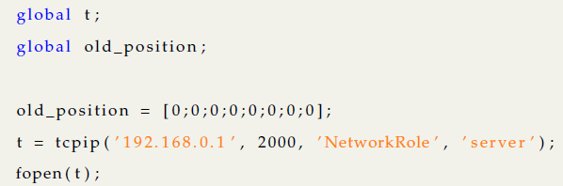
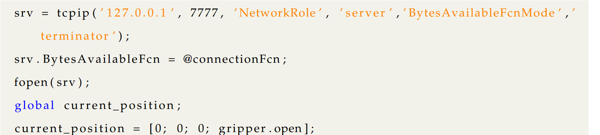
Matlab
Connection to PLC
Connection to Python Server

Slide 9
Matlab 2
There is then a third Matlab software called ConnectionFcn, used to sync up to the PLC position pulled from the first connection software.
This code, too long to be included in a slide, serves the purpose of sending the right command movement to the PLC based on whichever control system it’s connected to it.
As for this project, the control system used is a Speech Recognition software and therefore this is what Matlab is going to use as input.

Slide 10
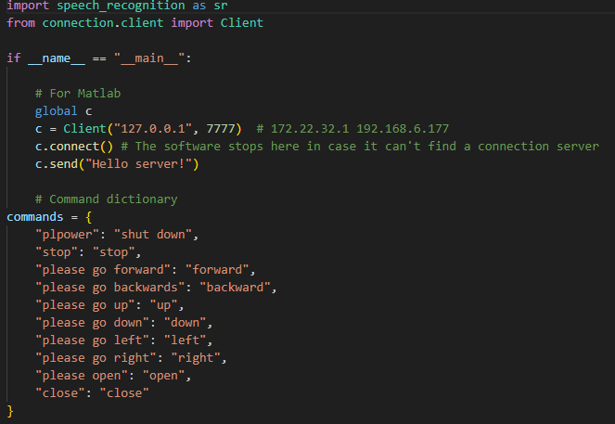
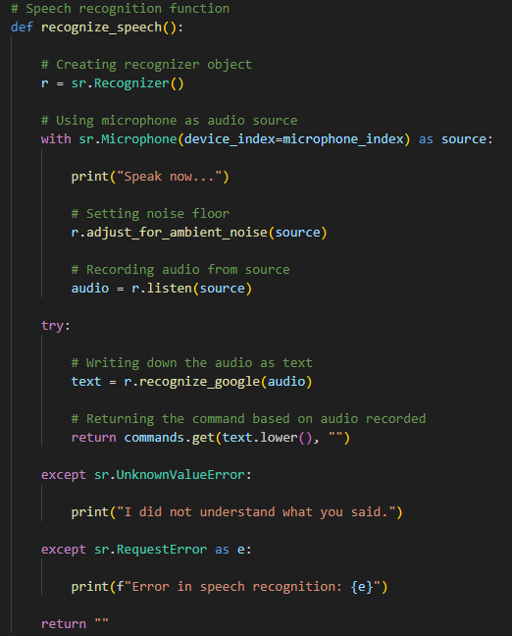
Python Speech Recognition
This is the initial part of the software that has been written to act as the control center for the robotic arm.
In this section we declare the global variables for Matlab and the command dictionary to be used as a reference in deciding which command to send.
This is the main function for recording the user’s voice, this function is going to be called everytime a command needs to be sent.
First the function adjusts for ambient noise, then it recognizes the user’s voice by using Google’s algorithm and it then compares what was said to the commands available in the dictionary.
There are also 2 exceptions created in case of error.

Slide 11
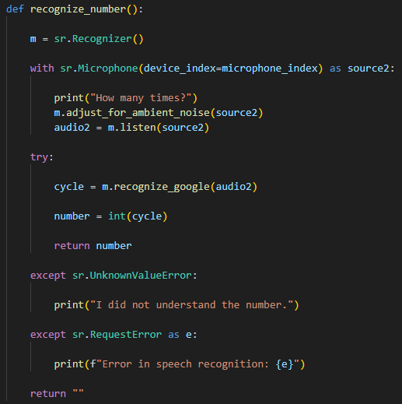
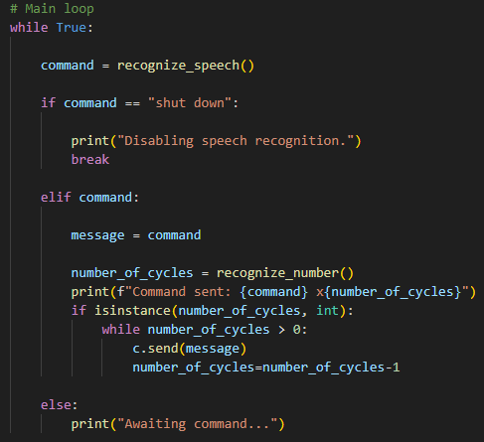
Python Speech Recognition 2
This function works the same way as the previous one, except instead of scanning the user’s voice for a text command, it scans for a number, which will eventually get compared to a list of natural numbers which will dictate how many times the software needs to send the command to be performed.
This last code is our main loop, it consists of a series of ifs and else ifs which will make the software flow through the previously declared functions, sending the chosen command for the declared number of times, all thanks to a while loop.

